Slide 1
Deel - Globepay Acceptance Report
Igor Levecharov

Slide 2
Agenda
Introduction
Key Facts of Input Data
Task 1
Task 2
Summary

Slide 3
Introduction
Deel has connectivity into Globepay using their API. Deel clients provide their credit and debit details within the Deel web application, Deel systems pass those credentials along with any relevant transaction details to Globepay for processing.
Problem
Deel is experiencing a decline in the acceptance rate of credit and debit card payments processed by Globepay in the recent period.

Slide 4
Key Facts of Input Data
Globepay Acceptance Report.csv
Globepay Chargeback Report.csv
5430 rows and 11 columns
There are no missing values
Index
external_ref as a key column
Date Time
date_time column
Categorical / boolean:
state (ACCEPTED, DECLINED)
cvv_provided (True, False)
country ['US' 'MX' 'UK' 'FR' 'CA' 'AE’]
currency ['USD' 'MXN' 'GBP' 'EUR' 'CAD’]
Numerical
amount
Rates
daily rate in JSON format
5430 rows and 11 columns
There are no missing values
external_ref as a key column (foreign key to Acceptance Report)
chargeback(True, False)

Slide 5
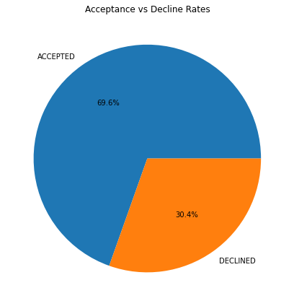
Task #1
1. Outlines the volume (in USD) of the declined payments
The total number accepted payments: 3777
The total number declined payments: 1653
The total volume in USD of the accepted payments: $299,393,932.42
The total volume in USD of the declined payments: $ $130,877,578.83
Acceptance rate is: 69.6%
Declining rate is: 30.4%
* ConvertToUsd function is created to convert the amount to USD using rates column for each transaction

Slide 6
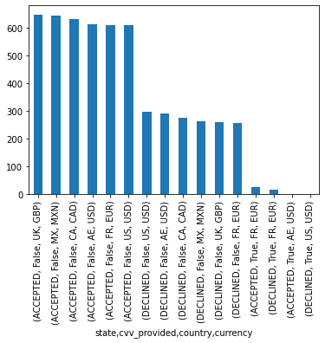
Task #1
2. Analyses the problem root causes
We run a group summary statistics by:
state
cvv_provided
Country
currency.
Here are the findings:
There is a large amount declined transactions that don’t have provided CVV. This could be serious root cause.
CVV not provided in US with USD currency have a large amount of failed transaction.
Most accepted transaction are from UK with GBP currency and without CVV provided.

Slide 7
Task #1
3. Lists further next steps (hypothesis / analysis) you would do as a next steps having more time and business knowledge
If CVV is provided will the increasing in the acceptance rate be significant
Does changing the currency/country combination will significant decrease failure rate
Is there is any specific time/date where transactions are more successfully
Is there is any specific amount range where transactions are more successfully
Implement ML Classification Algorithm (BinaryClasification, Decision Tree, SVM, XGBoost etc) that will predict if the transaction will be declined or approved
Transaction segmentation by amount range. What amount range have more successfully transactions
Run time-series analysis and/or prediction

Slide 8
Task #1
4. Suggests solutions / recommendations
Add CVV to be required field on the Web payment form
Build a model that based on input data will predict the outcome of the transaction
If probability of the failed transaction is more than 50%, suggest to the end customer changes in country/ currency combination
Based on the output of the segmentation process focus marketing campaigns on those courtiers, currency that have large acceptance rate

Slide 9
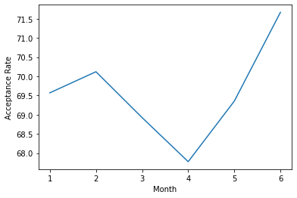
Task #2
date_time | accepted | declined | total | acceptance_rate
January | 647 | 283 | 930 | 69.57
February | 589 | 251 | 840 | 70.12
March | 641 | 289 | 930 | 68.92
April | 610 | 290 | 900 | 67.78
May | 645 | 285 | 930 | 69.35
June | 645 | 255 | 900 | 71.67
1. What is the acceptance rate over time?
The date range of data is from: Jan ‘19 – June ’19
There are few transformations done on the datasets
We will track the monthly changes
Acceptance rate start at 69.57% for January, drop to 67.78% in April
In the last two months there is grow to max 71.67%

Slide 10
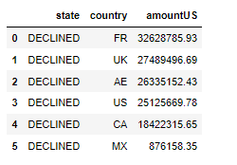
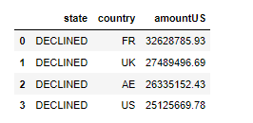
Task #2
2. List the countries where the amount of declined transactions went over $25M
The list of courtiers is the following:
['FR', 'UK', 'AE', 'US']

Slide 11

Task #2
3. Which transactions are missing chargeback data?
The two datasets are merged and filtered by chargeback = False
We run a group summary statistics by:
state
cvv_provided
Country
currency.
Based on the summary statistics we can divide these transactions in 2 main clusters:
Cluster One (Accepted transaction, with CVV not provided, from UK, MX, FR, AE and US, that have GBR, MXN, CAD EUR and USD currency)
Cluster Two (Declined transactions, with CVV not provided, from US, AE, CA, MX, UK and FR, that have USD, CAD, MXN, GBR and EUR currency)

Slide 12
Summary
Having CVV required in the form should probably increase the acceptance rate. It needs to be A/B tested.
Additional analysis including Supervised and Unsupervised Learning and need to be done for predicting acceptance rate and transaction segmentation.
Date time analysis and forecasting could possibly unlock hidden patterns and give more insights of the data.

Slide 13
Thank you
Igor Levecharov​
Igor.levecarov@gmail.com

